Slide 1
File Processing (CSC 432) Lecture 6 – Data Compression
Dr. Iheanetu
CIS Department

Slide 2
Objectives
Understand what data compression is and its importance
Understand data compression types and be able to differentiate between them
Understand lossless compression encoding techniques - Run-length, Huffman, and Lempel Ziv
Understand lossy compression methods - JPEG and MPEG

Slide 3
Definition of Data Compression
Process of reducing the amount of data required to represent a given information quantity
Encoding information using fewer bits than the original representation
The art of reducing the number of bits needed to store or transmit data
Data compression means sending or storing a smaller number of bits

Slide 4
Importance of Data Compression
Compression reduces the size of a file. Data compression helps to:
Save space when storing data
Save time when transmitting data (bandwidth maximization)
Note: Compression strategy depends on data type

Slide 5
Note
Computational resources are consumed in the compression and decompression processes
Data compression reduces the amount of resources required to store and transmit data.
The design of data compression schemes involves trade-offs among various factors like -
The degree of compression
The amount of distortion introduced (when using lossy compression technique)
The computational resources required to compress and decompress the data

Slide 6
Importance of Data Compression
Reduces data space
Reduces the retrieval time for compressed data
More responsive sites
Less risk of interruption or corruption
Allows servers to handle more traffic

Slide 7
Importance of Data Compression
Compression of encrypted files can add a layer of security – most compression techniques create a hash map for your data
Mobile devices and Cellular Networks
Energy Conservation
Storage costs scale with your business

Slide 8
How Compression Works
Basic compression algorithms go through a file looking for common strings in the file
Erases duplicate strings and uses a marker file that points to a duplicate retained
The more strings that match the better because it saves space invariably
Decompression will insert the file back in its original position and the file occupies same amount of space, as before compression

Slide 9
How Compression Works
1 2 3 4 5
6 4 3 7 7
4 7 4 8 3
1 2 3 4 5
6 4 7 3 8
7 3 6 4 1
1 2 3 4 5
9 0 4 2 6
1 2 3 4 5
6 4 3 7 7
4 7 4 8 3
M
6 4 7 3 8
7 3 6 4 1
M
9 0 4 2 6

Slide 10
How Compression Works Cont’d
Compression is not automatic, it is based on demand
Space used for compression is broken up into block sizes which can be set with the compression utility desired
The default of one block size is 1MB – called compression chunk size

Slide 11
How Compression Works Cont’d
To read data, a file (Chunk) is loaded into memory and decompressed there before it can be read, while the data block (chunk) still remains compressed
Multiple algorithms are available but Gzip is very popular and available, has strings 1-9, 1 = fastest, 9 = best, 6 = default

Slide 12
How Compression Works Cont’d
Performance orientation – loading a block into memory for read/ write operations and decompression takes time. Files frequently accessed for reads/writes operations should not be compressed

Slide 13
Information & Rate Distortion Theories - Claude Shannon
The theoretical background of compression is provided by
Information theory for lossless compression and
Rate–distortion theory for lossy compression.
These areas of study were essentially created by Claude Shannon in the late 1940s and early 1950s.

Slide 14
Types of Compression
1. Lossy Compression
2. Lossless Compression
Compression Efficiency = Ratio of uncompressed file to ratio of compressed file.
This is the compression ratio

Slide 15
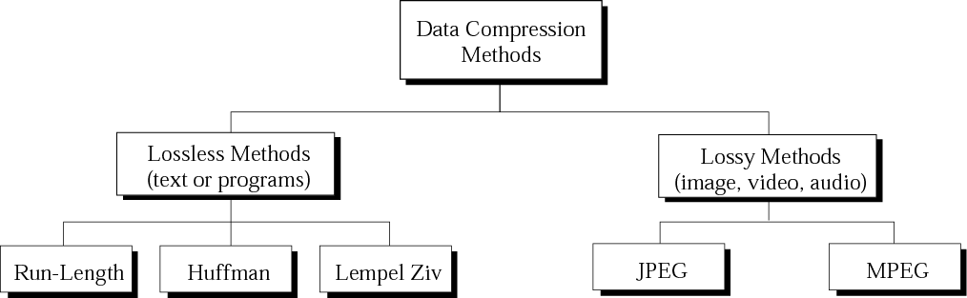
Types of Data Compression

Slide 16
LOSSLESS DATA COMPRESSION

Slide 17
Keeps reference to redundant files and can reconstruct them when needed so that decompressed file is identical to uncompressed file

Slide 18
Lossless data compression algorithms usually exploit statistical redundancy to represent data without losing any information
Compression is reversible
Possible because most real-world data exhibits statistical redundancy
Example
An image may have areas of color that do not change over several pixels; instead of coding "red pixel, red pixel, ..." the data may be encoded as "279 red pixels".
This is a basic example of run-length encoding

Slide 19
Data integrity is preserved.
The original data and the data after compression and decompression are exactly the same because the compression and decompression algorithms are exactly the inverse of each other
Examples:
Lempel Ziv (L Z) encoding (dictionary-based encoding)
Run-length encoding
Huffman encoding

Slide 20
Lempel-Ziv Welch (L ZW) Encoding

Slide 21
Most popular algorithm for lossless compression
Use a table-based compression model where table entries are substituted for repeated strings of data.
Table is often Huffman encoded

Slide 22
How LZW compression Works
Looks for repeated strings in a file and adds them to a dictionary
Tries to find optimal mapping by looking at sub strings and sub-sub strings
Can compress certain text files to roughly half their size
Example “Mississippi’ → “M&i&#i” where ‘iss’= & and ‘pp’ =#

Slide 23
Pros and Cons of LZW
Useful only when redundancy is high
Dictionary can grow large
Does not work well with human languages because the dictionary will grow really large

Slide 24
Lempel Ziv encoding
LZ encoding is an example of a category of algorithms called dictionary-based encoding.
The idea is to create a dictionary (table) of strings used during the communication session.
The compression algorithm extracts the smallest substring that cannot be found in the dictionary from the remaining non-compressed string.

Slide 25
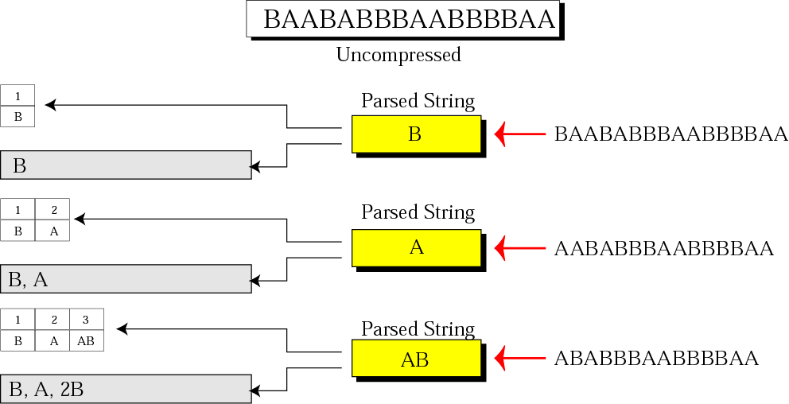
Figure 15-8:Part I
Example of Lempel Ziv encoding

Slide 26
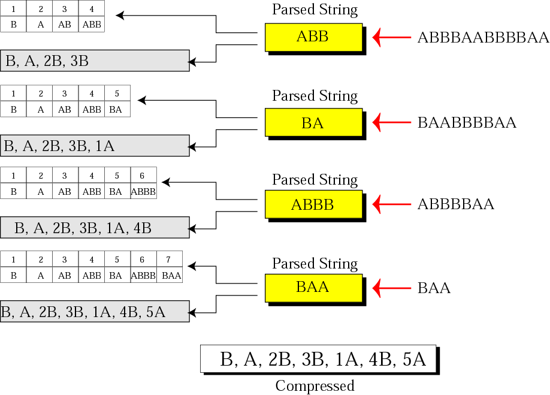
Figure 15-8:Part 2
Example of Lempel Ziv encoding

Slide 27
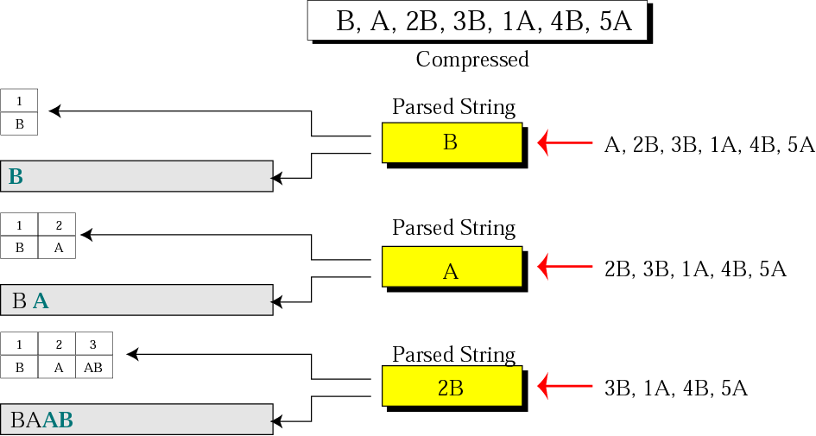
Figure 15-9: Part I
Example of Lempel Ziv decoding

Slide 28
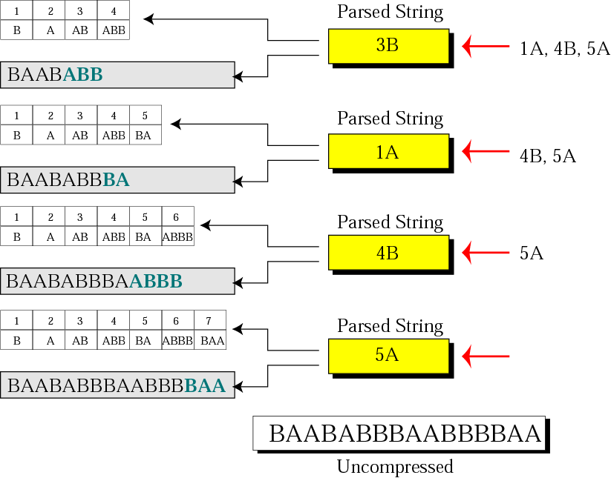
Figure 15-9: Part II
Example of Lempel Ziv decoding

Slide 29
Huffman Encoding

Slide 30
Relies on assigning the shortest possible symbol to represent the bit string that occurs most frequently
Used in PDF compression
Given a sequence of elements, organizes elements into a tree, based on probability of occurrence
Once tree is created, each element has a Huffman code, which is a sequence of 0s and 1s representing its path through the tree

Slide 31
Pros and Cons
Very fast
Lossless
Dictionary stays small
Implementation is difficult
High space complexity due to tree construction

Slide 32
In Huffman coding, you assign shorter codes to symbols that occur more frequently and longer codes to those that occur less frequently.
For example:
Table 1 - Frequency of characters
Character A B C D E
------------------------------------------------------
Frequency 17 12 12 27 32

Slide 33
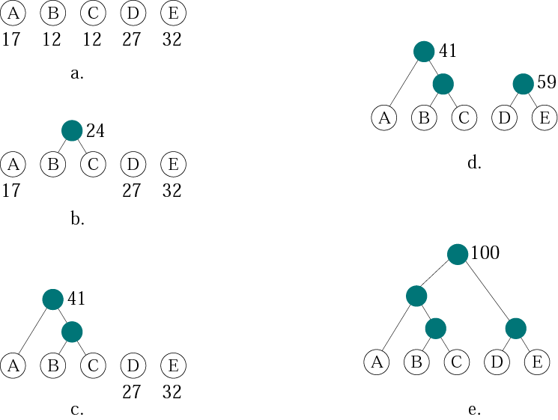
Figure 15-4
Huffman coding

Slide 34
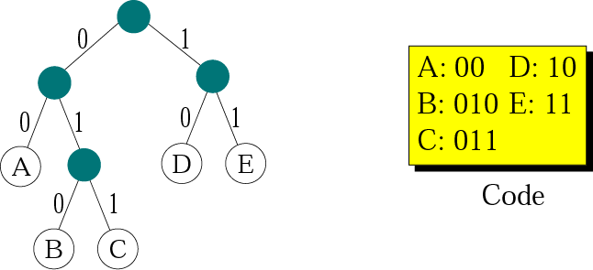
Figure 15-5
Final tree and code

Slide 35
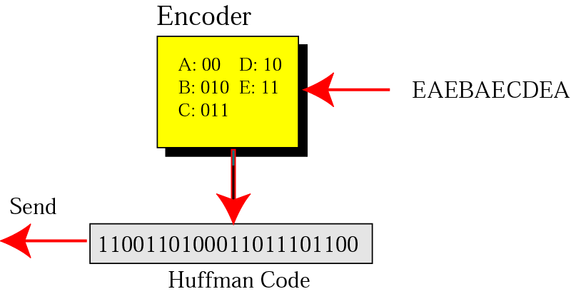
Figure 15-6
Huffman encoding

Slide 36
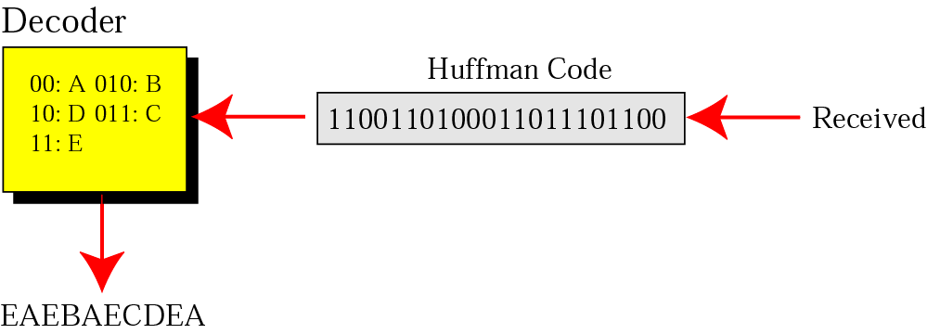
Figure 15-7
Huffman decoding

Slide 37
Huffman coding
The beauty of Huffman coding is that no code in the prefix of another code.
There is no ambiguity in encoding.
The receiver can decode the received data without ambiguity.
Huffman code is called instantaneous code because the decoder can unambiguously decode the bits instantaneously with the minimum number of bits.

Slide 38
Run-length Encoding

Slide 39
Tries to replaces the consecutive occurrences of a given symbol with only one copy of the symbol along with a count of how many times that symbol occurs. Hence the names run length.

Slide 40
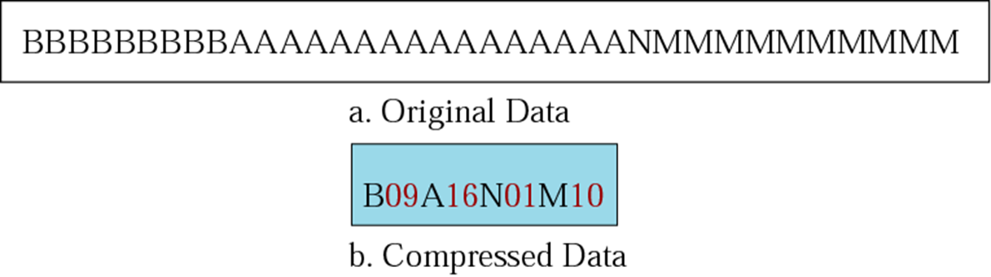
It does not need knowledge of the frequency of occurrence of symbols and can be very efficient if data are represented as 0s and 1s.
For example:

Slide 41
This method of compression must be used carefully. If there is not a lot of repetition in the data then it is possible the run length encoding scheme would actually increase the size of a file.

Slide 42
Application
A real life example where run-length encoding is quite effective is the fax machine. Most faxes are white sheets with the occasional black text.
A run-length encoding scheme can take each line and transmit a code for while then the number of pixels, then the code for black and the number of pixels and so on.

Slide 43
Brain Teaser
What is the best data compression algorithm?

Slide 44
Hint
Compressed size?
What about speed?
Or resource usage (e.g. memory)? What about availability on other systems?
Feature set (like self extraction, encryption, volume splitting, streamable content, etc.)?
What sort of data is it intended for (e.g. only text, executables, media streams, databases, etc.)?
Should lossless compressions be included in the mix?

Slide 45
Good compression is often a balance between file size reduction, speed and ease of implementation
Most popular methods involve analyzing the content and dynamically choosing strategies based on that content
*Best strategy is the one that can make inferences about data types being compressed*
The next big innovation in compression technology will likely come from improvements in predicting the input data

Slide 46
How Well Can You Hear Audio Quality? http://goo.gl/z0hBhx
Hint: Turn your volume up.

Slide 47
TEST YOUR KNOWLEDGE
Try to design and implement your own library of compression and decompression routines/objects/
Test them out against any existing zip files or tar archives or compressed data you can find
Check if other decompression programs can correctly handle what your stuff compresses -- assuming implementations of the same compression scheme(s).
Were you surprised at the errors and inconsistencies?

Slide 48
LOSSY DATA COMPRESSION

Slide 49
Some loss of information is acceptable.
Deleting redundant/ nonessential detail from the data source can save storage space
JPEG image compression works in part by rounding off nonessential bits of information.
There is a corresponding trade-off between preserving information and reducing size.

Slide 50
APPLICATIONS
Used in digital cameras, to increase storage capacities with minimal degradation of picture quality
DVDs use the lossy MPEG-2 video coding format for video compression.
In lossy audio compression, methods of psychoacoustics are used to remove non-audible (or less audible) components of the audio signal

Slide 51
APPLICATIONS CONT’D
Compression of human speech is done with more specialized techniques. Speech / voice coding is a different from audio compression
Voice compression is used in internet telephony
Audio compression is used for CD ripping and is decoded by the audio players

Slide 52
Loss of information is acceptable in a picture of video.
The reason is that our eyes and ears cannot distinguish subtle changes.
Loss of information is not acceptable in a text file or a program file.
For examples:
Joint photographic experts group (JPEG)
Motion picture experts group (MPEG)

